Slide 1

Superstore
Superstore BI
& Data
Analytics
Analytics
End-to-End Business Intelligence Solution
Transforming Data into Actionable Business Insights
PRESENTED BY
Mohanad Ibrahim
BI &
Data

Slide 2




01
02
03
04
STAR SCHEMA DATABASE ARCHITECTURE
ADVANCED SQL ANALYTICS
INTERACTIVE POWER BI DASHBOARDS
STRATEGIC BUSINESS RECOMMENDATIONS
Professional star schema with central fact table and six dimension tables optimized for complex analytics and scalable data growth.
Custom DAX measures, decomposition trees, and Azure maps delivering executive-ready visualizations and drill-down capabilities.
Complex CTEs, window functions, and self-joins enabling profitability audits, market basket analysis, and dynamic ranking.
Data-driven insights translated into actionable initiatives for marketing, operations, and product portfolio optimization.
End-to-end BI solution using US Superstore dataset: 9,994 transactional records over 4 years. Demonstrating advanced data engineering, SQL analytics, and interactive Power BI dashboards to optimize profitability.
Project Overview

Slide 3
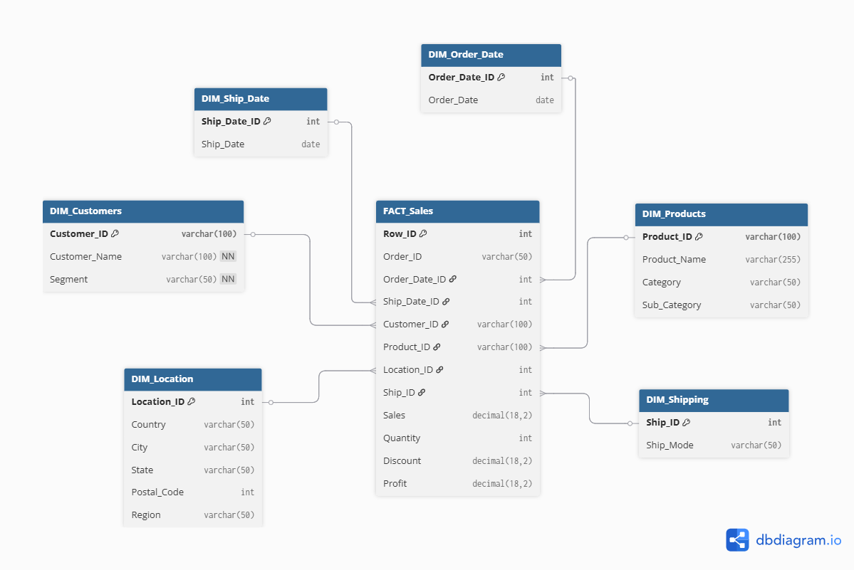
03
Technical Architecture & Data Model
STAR SCHEMA DATABASE DESIGN IN SQL SERVER
Central Fact Table: FACT_Sales containing transactional measures including Sales, Profit, Quantity, and Discount metrics for comprehensive business analysis.
DIM_Customers: Customer profiles & segmentation
DIM_Products: Categories and sub-categories
DIM_Location: Geographic hierarchy data
DIM_Shipping: Shipping modes & logistics
DIM_Order_Date & DIM_Ship_Date: Time dimensions

Slide 4
Advanced SQL Analytics
04
DEMONSTRATING TECHNICAL DEPTH WITH SQL
01
02
03
04
COMMON TABLE EXPRESSIONS
WINDOW FUNCTIONS
SELF-JOINS ANALYSIS
PROFITABILITY AUDITS
Modular, readable queries for complex business logic
ROW_NUMBER, RANK, PARTITION BY for dynamic rankings
Market Basket Analysis for co-purchased products
Detecting loss-making customers and products

Slide 5
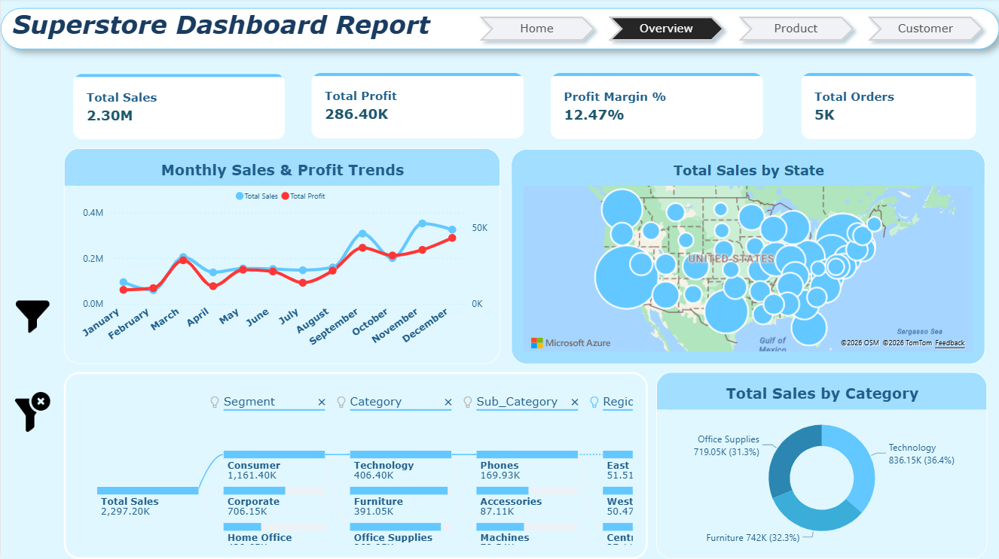
05
Key Performance
Indicators
BUSINESS PERFORMANCE SNAPSHOT
12.47%
With $2.3 million in total sales and a profit margin of 12.47%, the Superstore dataset represents a healthy retail operation. Nearly 800 customers generated 5,000 orders across 38,000 units sold, averaging $2,900 per customer. This strong customer value indicates effective pricing strategies and customer engagement, providing a solid foundation for strategic growth initiatives.
Profit Margin

Slide 6
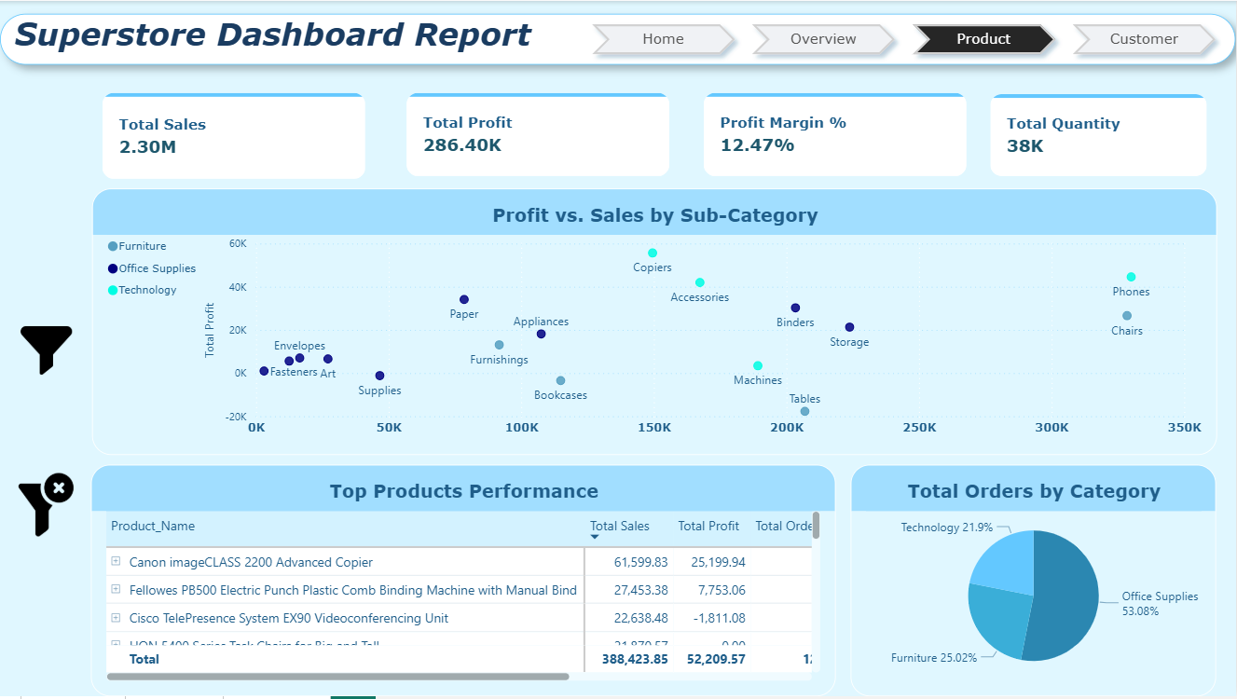
06
Business Overview Dashboard
EXECUTIVE SUMMARY DASHBOARD INSIGHTS
This executive dashboard reveals key business patterns: Monthly sales and profit trends show clear Q4 seasonality with holiday peaks. Geographic analysis highlights West region leadership in revenue. The decomposition tree enables flexible drill-down from Segment to Category to Sub-category to Region. Sales distribution shows Office Supplies, Technology, and Furniture category breakdown.
Q4
PEAK SALES SEASONALITY

Slide 7


Product Performance
VOLUME VS VALUE PARADOX
Office Supplies dominates order volume at 53.08%, yet Technology captures the highest revenue share at 36.4% despite only 21.9% of orders. This paradox reveals where true profitability lies and informs strategic marketing decisions.
53%
01
OFFICE SUPPLIES VOLUME
TOP PERFORMING PRODUCTS
02
Canon imageCLASS 2200 Copier leads with $61.6K in sales and $25.2K profit. Fellowes PB500 Electric Punch follows with $27.5K sales. Cisco TelePresence System shows $22.6K sales but a -$1.8K loss requiring audit.
DATA PREPARATION
Office Supplies leads in order volume but contributes lower revenue share.
STRATEGIC RECOMMENDATION
VOLUME VS VALUE
Shift marketing investment toward high-margin Technology bundles and hero products. Conduct profitability audits on loss-making items like Cisco TelePresence to determine pricing adjustments or discontinuation.
Technology at 21.9% volume drives 36.4% of total revenue.
03
HERO PRODUCT
Canon imageCLASS 2200 Copier: $61.6K sales, $25.2K profit.

Slide 8
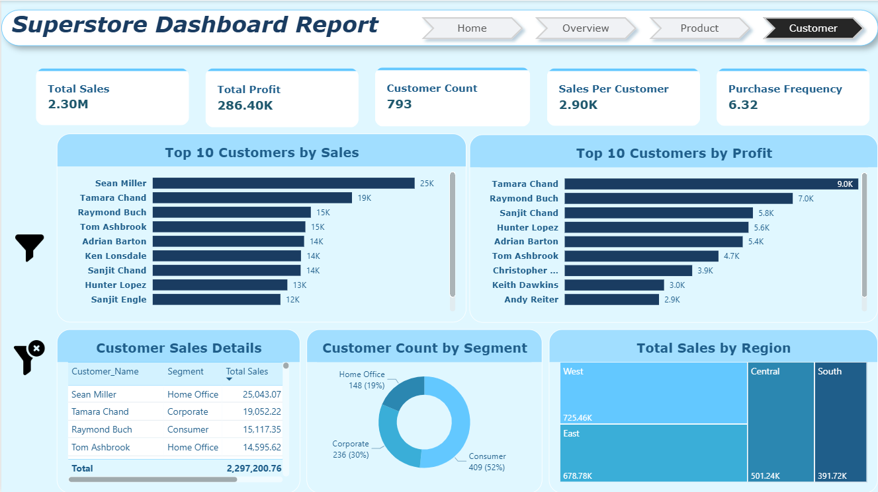
08
Customer
Insights
UNDERSTANDING CUSTOMER PROFILES AND REGIONAL SALES PERFORMANCE
52%
Customer segmentation reveals Consumer dominance at 52% (409 customers), followed by Corporate at 30% and Home Office at 19%. Regional analysis shows West leading with $725.46K in sales, while South lags at $391.72K, indicating growth opportunities. Top performers include Sean Miller, Tamara Chand, and Raymond Buch, representing key accounts for targeted retention programs and VIP engagement strategies.
Consumer segment share of customer base

Slide 9

09
Key Business Insights Summary
CRITICAL STRATEGIC DISCOVERIES
Volume vs. value paradox: Technology drives 36.4% revenue with only 21.9% order volume—prioritize over Office Supplies.
Consumer segment dominates at 52% of customer base, necessitating targeted loyalty and retention programs.
Regional performance gap: West leads at $725K while South lags at $392K—opportunity for operational replication.
Loss-making products identified for audit; strong Q4 seasonality enables inventory and staffing optimization.

Slide 10
10
Strategic Recommendations
ACTIONABLE BUSINESS INITIATIVES
02
04
REALLOCATE
MARKETING
REPLICATE WEST SUCCESS
Increase Technology promotion by 25%, reduce Office Supplies mass marketing.
Operational audit and pilot initiatives in South region to boost sales by 20%.
LAUNCH LOYALTY PROGRAM
OPTIMIZE
PORTFOLIO
01
Tiered rewards targeting 52% Consumer segment to boost repeat purchases by 15%.
03
Audit loss-makers, adjust pricing or discontinue, promote hero products.

Slide 11




01
02
03
04
DATA ENGINEERING
ADVANCED SQL
POWER BI & DAX
BUSINESS INTELLIGENCE
Star schema database design with optimized fact and dimension tables. ETL pipeline development and data quality management for reliable analytics foundations.
Complex CTEs for modular queries, window functions (ROW_NUMBER, RANK, PARTITION BY), self-joins for market basket analysis, and query performance optimization.
Custom DAX measures, interactive dashboards, advanced visualizations including decomposition trees and Azure maps for geographic insights.
KPI definition and tracking, trend analysis, customer segmentation, profitability audits, and actionable insight generation.
Comprehensive BI competencies spanning the full analytics lifecycle—from data engineering and advanced SQL to sophisticated Power BI dashboards and strategic business intelligence.
Technical Skills Demonstrated

Slide 12


Thank You!
Questions &
Discussion
Welcome
Superstore
BI & Analytics
Transforming $2.3M in transactional data into strategic business insights. I look forward to discussing how I can contribute to your team. Questions welcome.

